Slide 2
Missingness & Imputation

Slide 3
Transformations

Slide 4
Standardization

Slide 5
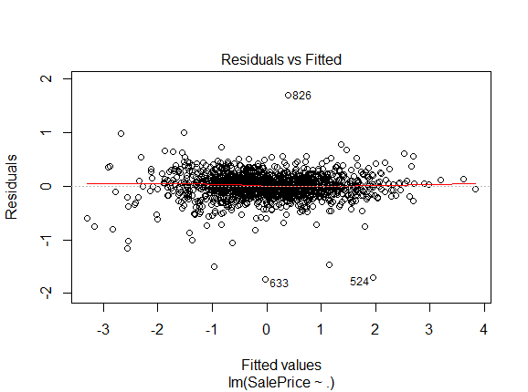
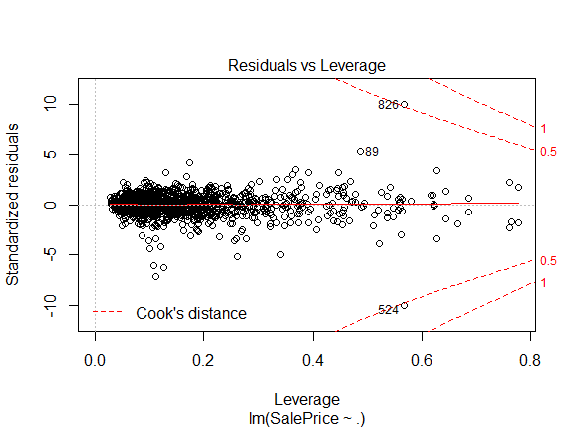
Outliers

Slide 6
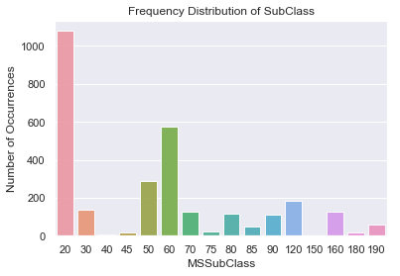
Feature Engineering - Sparse Categoricals
MSSubClass
MSZoning
LotShape
LandContour
Utilities
LotConfig
Condition1&2
RoofStyle
RoofMatl
Exterior 1st & 2nd
MasVnrType
HeatingQC
Electrical
Functional
GarageType

Slide 7
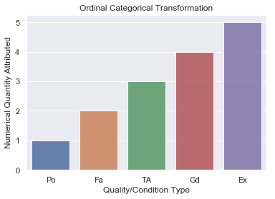
Feature Engineering - Ordinal Categoricals
ExterQual
ExterCond
BsmtQual
BsmtCond
HeatingQC
KitchenQual
FireplaceQu
GarageQual
GarageCond
PoolQC

Slide 8
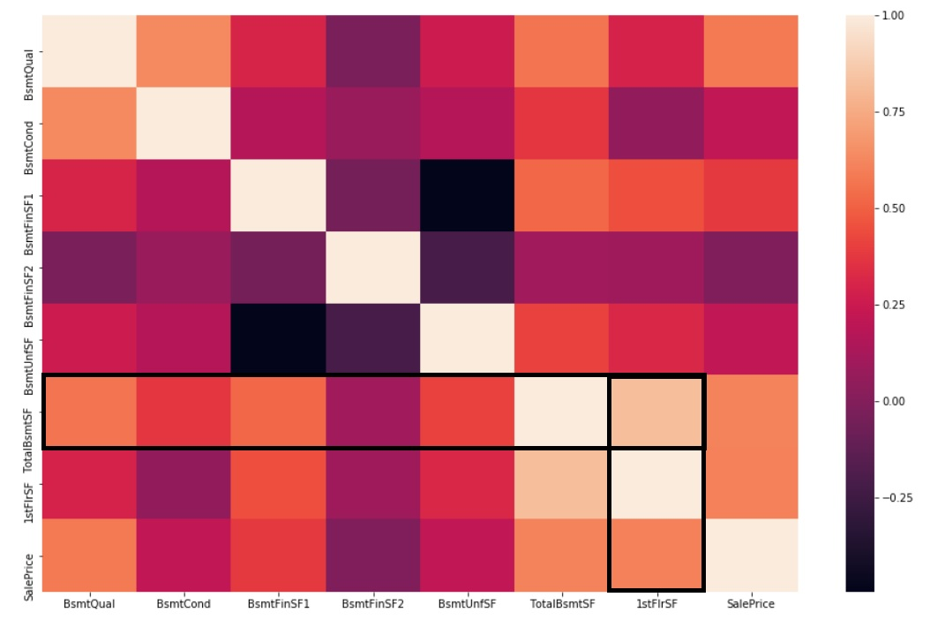
Feature Engineering - Basement
Multicollinearity Observed.
Removed Component Sqft.
Removed Total Sqft.
Score = Qual*Cond
Notes:
-Removed component square footage as this information is retained by total square footage.
-Since total basement square footage is highly correlated with first floor square footage, it is removed.

Slide 9
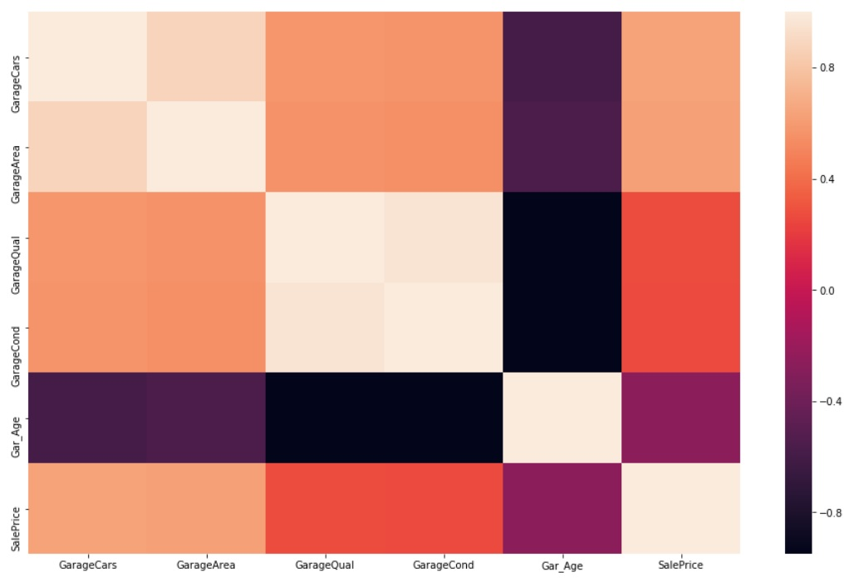
Feature Engineering - Garage
Removed GarageCars
Age= YrSold-YrBlt
Score = Cond*Qual*Age
Notes:
Garage area and number of cars are strongly correlated

Slide 10
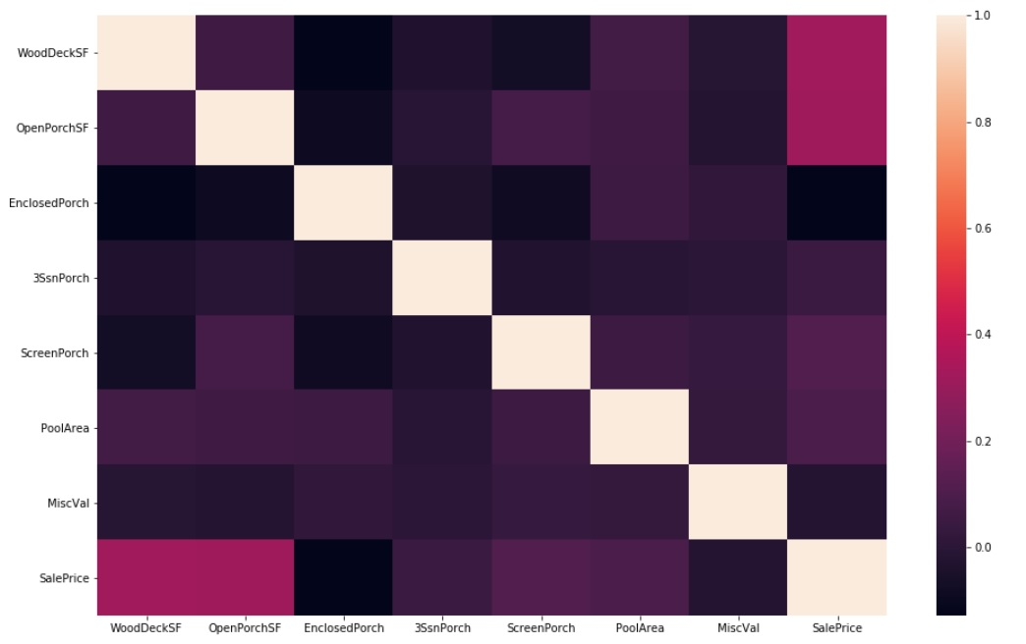
Feature Engineering - Porch
Minor Collinearity Amongst Features
Most Features Are Weakly Correlated With Sale Price.
Attempted Models With Only Wood Decks And Open Porch Square Footage.

Slide 11
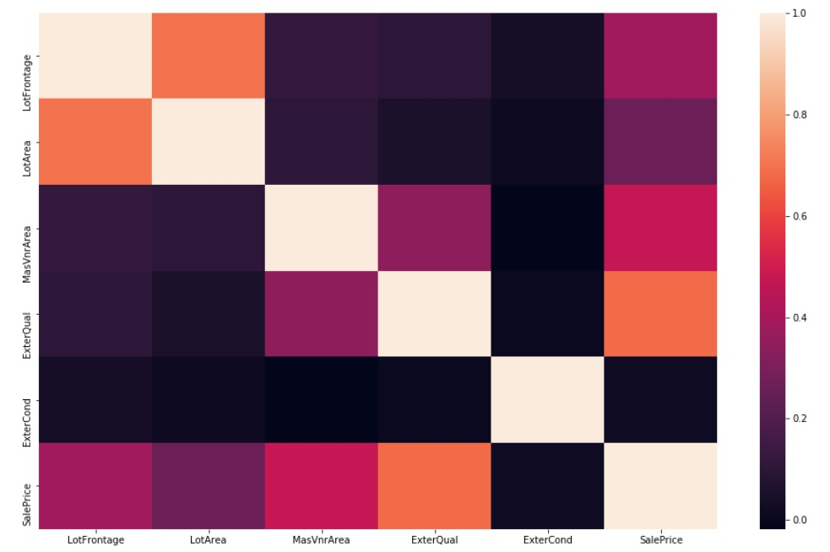
Feature Engineering - Exterior
Lot Frontage Removed Due To Collinearity And Physical Dependence.

Slide 12
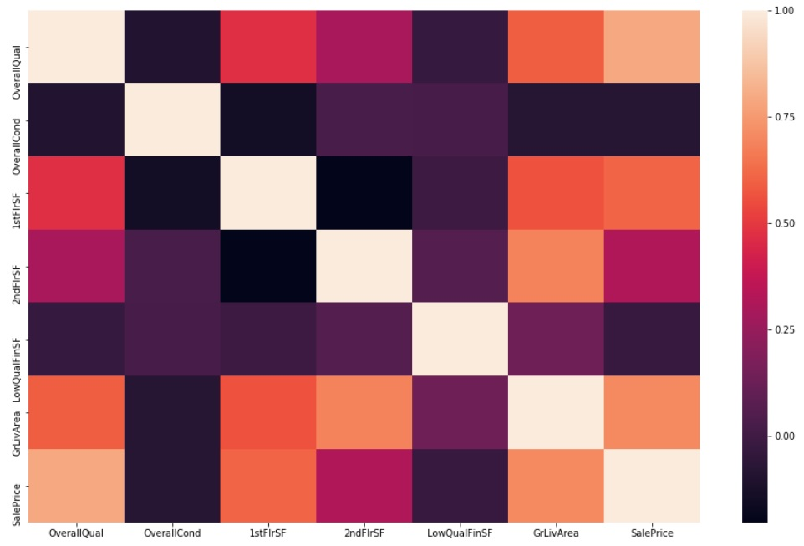
Feature Engineering - Interior & Overall Quality/Condition
1st Floor and 2nd Floor Square Footage are Removed and Represented by Above Grade Living Area.

Slide 13
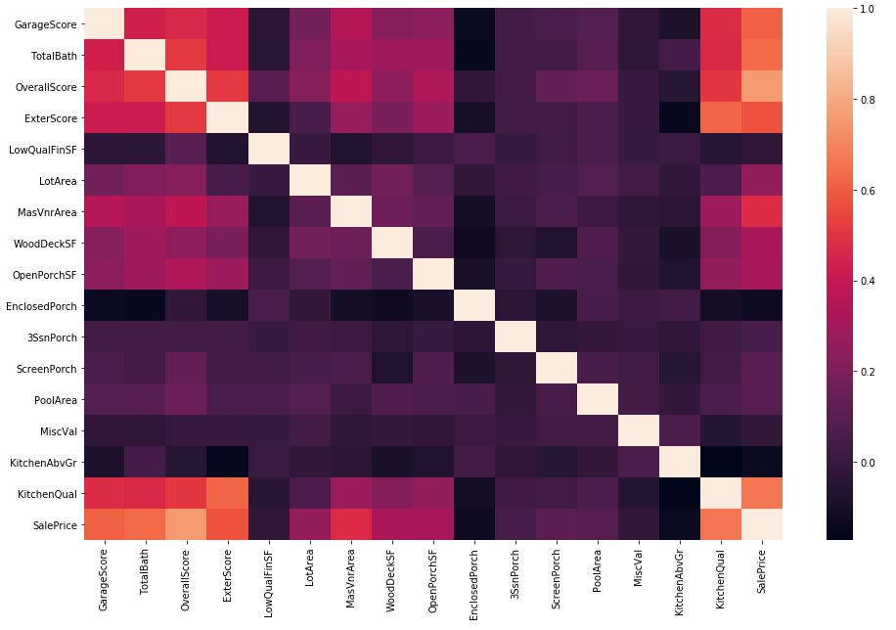
Correlation Matrix Post Feature Engineering
Most of the strong multicollinearity has been removed amongst continuous features.

Slide 14
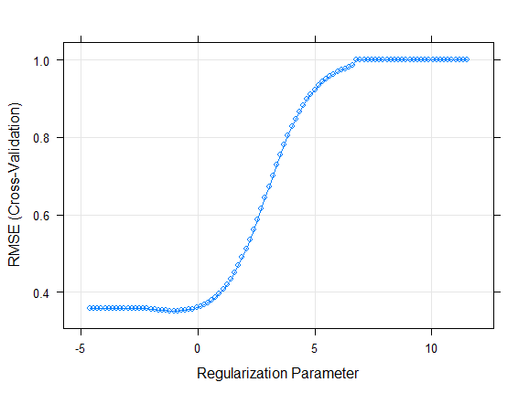
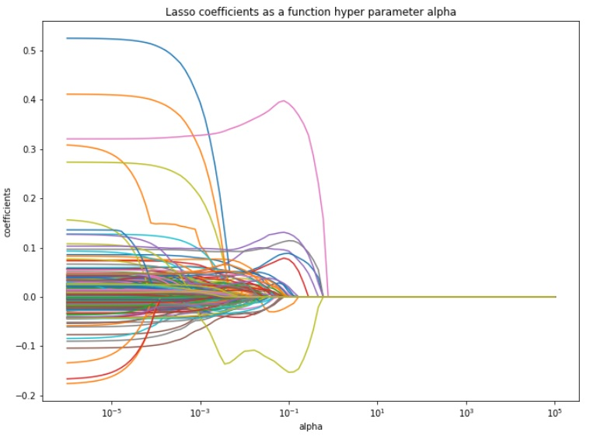
Machine Learning - Regularized Regression - Lasso
5-Fold Cross Validation for Hyper Parameter Selection
Best Alpha ~ .01

Slide 15
Lasso - Features Selected
LotArea YearRemodAdd MasVnrArea BsmtQual HeatingQC KitchenQual TotRmsAbvGrd Fireplaces FireplaceQu WoodDeckSF OpenPorchSF EnclosedPorch
ScreenPorch PoolArea PoolQC MSZoning_FV MSZoning_RL Street_Pave LotConfig_CulDS Neighborhood_BrkSide Neighborhood_ClearCr Neighborhood_Crawfor
Neighborhood_NoRidge Neighborhood_NridgHt Neighborhood_Somerst Neighborhood_StoneBr Neighborhood_Veenker Condition1_Norm HouseStyle_1Story RoofStyle_Hip Exterior1st_BrkFace Exterior1st_MetalSd MasVnrType_Stone Foundation_PConc BsmtExposure_Gd
BsmtFinType1_GLQ Heating_GasW CentralAir_Bin OverallScore TotalBath Functional_Typ GarageType_Attchd GarageScore PavedDrive_Y Fence_NA MiscFeature_NA SaleType_New SaleCondition_Normal

